Slide 1

Extracting Features from and Standardizing Phoneme Features
Mezisashe Ojuba
3rd July 2024.

Slide 2
Dataset Used
DARPA TIMIT Acoustic-Phonetic Continuous Speech Corpus(TIMIT)
30 first files (when retrieved in order) from the DEV subset

Slide 3
Method
Feature extraction using MATLAB.
Sliced the signal to get the phoneme and processed up until the third process in default clinical map: FFT_filterbank_proc, Power_sum_envelope_proc, Gain_proc'
Visualize features for phonemes using umap and matplotlib.
Used first 100 values for each phoneme instance and padded with 0s if feature length < 100
Standardize features using Zmuv normalization.
For a phoneme, normalize by class: subtract from the mean and divide by standard deviation.
Group features by manner of articulation
Visualize the normalized features.
Visualize/plot the average phoneme for each phoneme class.
Look at the difference in pattern between normalized and un-normalized features.
Notes:
Padding makes data sparser.

Slide 4
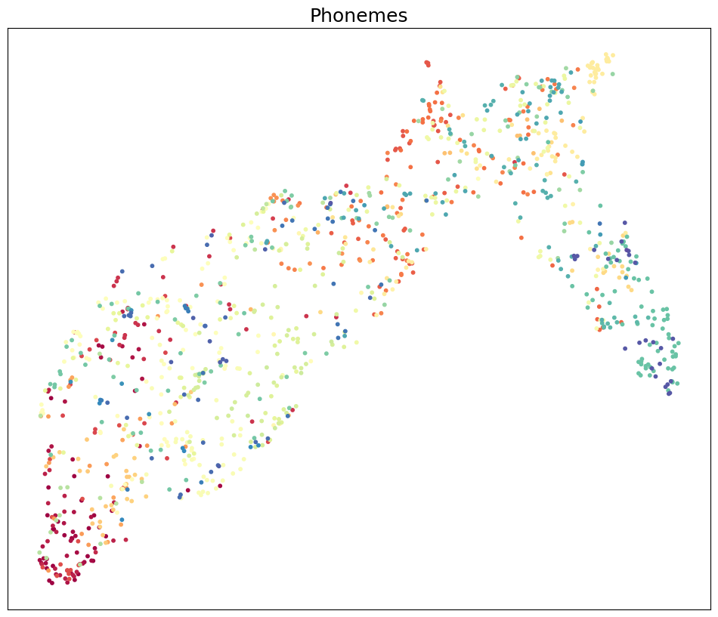
Raw Feature Visualization
Visualizing all 60 phonemes (colour-coded)

Slide 5
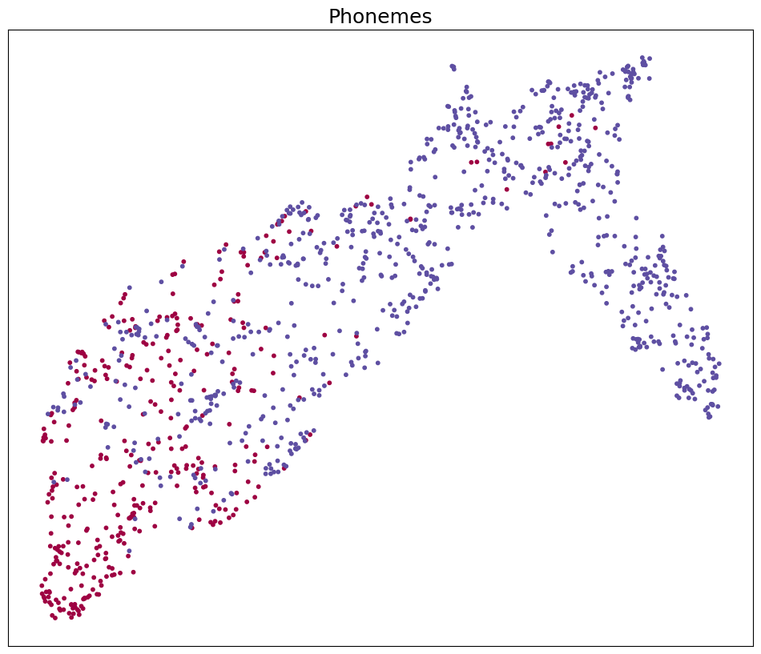
Raw Feature Visualization
Visualizing all vowel vs consonant phonemes (colour-coded)

Slide 6
Zmuv normalization
Normalize the features in matlab and get the average feature
Save the normalized features
Visualize the normalized features and average. Compare with un-normalized features.
Notes:
Since using matlab for this is neat. Theres a function that already does so, and I can read the features directly.

Slide 7
References
https://umap-learn.readthedocs.io/en/latest/
TIMIT: https://catalog.ldc.upenn.edu/LDC93S1

